Slide 1

HELLO!
Here 1Crore Projects
I am here because I love to give presentations.
You can find me at @1CROREPROJECTS

Slide 2
EAFS: AN EFFICIENT, ACCURATE, AND FORWARD SECURE SEARCHABLE ENCRYPTION SCHEME SUPPORTING RANGE SEARCH

Slide 3

AIM OF PROJECT
The main aim of the project is EAFS scheme, a trapdoor only matches the data record that satisfies the search range, and the other results are found iteratively using the previous result.

Slide 4
ABSTRACT
Forward privacy in existing searchable symmetric encryption approaches generally supports only keyword searches, rather than range searches.
Seeking to address these limitations, we formally propose the definition of the forward privacy for secure range searches.
The chain-like search and the embedded ciphertexts of OPE simultaneously guarantee its efficiency, forward privacy, and accuracy. We also use the simulation-based method to demonstrate that our scheme is secure.

Slide 5
INTRODUCTION
Our data are increasingly stored in cloud servers for a range of reasons, such as lower costs of data management, higher quality of service, and ability to access our data anywhere anytime using any computing device. In some cases, data are being outsourced to the CSs by default. There are known security and privacy issues associated with the outsourcing of data, such as the cloud service provider getting access to user contents without their explicit permission. This reinforces the importance of searchable , a cryptography based scheme that enables searching in the ciphertext domain without leaking any information to untrusted servers.

Slide 6
EXISTING SYSTEM
Existing works generally support only keyword searches but not give accurate search results. Therefore, this is the gap we seek to address, by designing a forward secure keyword search scheme that is not accurate and efficient.
In existing approaches that support search over encrypted datasets have limitations associated with efficiency, accuracy, and security.

Slide 7
DISADVANTAGES
The security and the performance is low.
Limited accuracy.

Slide 8
PROPOSED SYSTEM
In the proposed EAFS scheme, a trapdoor only matches the last data record that satisfies the search range, and the other results are found iteratively using the previous result.
We propose the first formal definition of forward privacy in secure range searches.
We design an EAFS SE scheme that supports secure range searches in encrypted databases. This is the first scheme that simultaneously achieves efficiency, accuracy, and forward security.

Slide 9
ADVANTAGES
The security and the performance is high.
Confidentiality of files while Upload/Download.

Slide 10
ALGORITHM
ABE
Attribute-based encryption (ABE) can be used for log encryption. Instead of encrypting each part of a log with the keys of all recipients, it is possible to encrypt the log only with attributes which match recipients' attributes.

Slide 11
Cipher text:
Cipher text is also known as encrypted or encoded information because it contains a form of the original plaintext that is unreadable by a human or computer without the proper cipher to decrypt it. Decryption, the inverse of encryption, is the process of turning cipher text into readable plaintext.

Slide 12
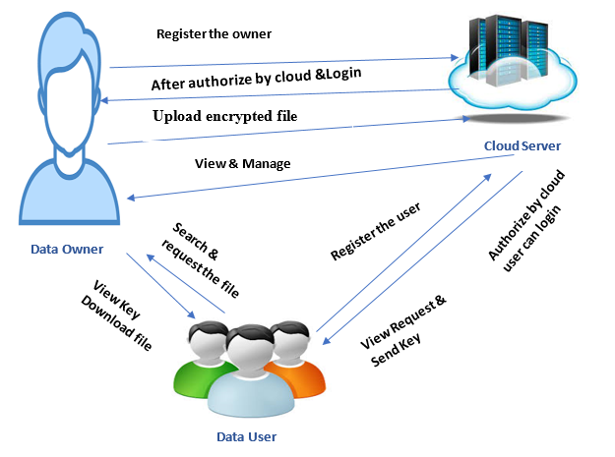
SYSTEM ARCHITECTURE

Slide 13
MODULES
In this project has three modules:
Data Owner
Data User
Cloud Server

Slide 14
DATA OWNER
Register the account with the basic information
After authorize by cloud owner can login the account
Upload the file with the encrypted format
View the file
Logout

Slide 15
DATA USER
Register the account with the basic information
After authorized by cloud server user can login the account
Search the file based on the keyword, if the keyword should be matching the file means that files should be shown
Make a request to cloud
View key and Download the File. After the file download that should be in decrypted format.
Logout

Slide 16
CLOUD SERVER
Login the account with the correct username and Password
Authorize the owner and user
View request for download the file and send the key
View all files in cloud
Graph
Logout

Slide 17
HARDWARE REQUIREMENTS
System | Intel i3 and above
Hard Disk | 40GB
RAM | Minimum 4GB
Processor | 64-bit, four-core, 2.5 GHz minimum per core

Slide 18
SOFTWARE REQUIREMENTS
Front End Language | HTML, CSS, JAVA, JSP SERVELTS
Backend | My SQL
Operating System | Windows 10 or 11
IDE | JAVADEVELIPEMENKIT

Slide 19
FUTURE WORK
In our future work is evaluated the security and performance of our approach to demonstrate the utility of the EAFS.

Slide 20
CONCLUSION
We proposed the definition of forward privacy in range search, and designed an EAFS SE scheme that supports secure range search in encrypted databases.
The computational cost for a range search in our EAFS only relates to the number of results that satisfy the query and the number of false positives in the intersecting buckets. The chain-like search ensures that any newly updated data entities have no relationship with the previous data, which achieves forward privacy.

Slide 21
REFERENCE
Y. Zhang, J. Katz, and C. Papamanthou, “All your queries are belong to us: The power of file-injection attacks on searchable encryption,” in Proc. USENIX Secur. Symp., 2016, pp. 707–720.
H. Hacigümüs, B. Iyer, C. Li, and S. Mehrotra, “Executing SQL over encrypted data in the database-service-provider model,” in Proc. Int. Conf. Manag. Data Conf., 2002, pp. 216–227.
B. Hore, S. Mehrotra, M. Canim, and M. Kantarcioglu, “Secure multidimensional range queries over outsourced data,” VLDB J., vol. 21, no. 3, pp. 333–358, 2012.
C. Mavroforakis, N. Chenette, A. Neill, G. Kollios, and R. Canetti, “Modular order-preserving encryption, revisited,” in Proc. SIGMOD Int. Conf. Manag. Data Conf., 2015, pp. 763–777.

Slide 22
THANKS!
Any questions?
You can find me at
Reach us – 1croreprojects@gmail.com
Contact / Whatsapp: 7708 150 152 / 9751 800 789 / 790 432 0834

